Slide 1

Venkata Alekhya Kusam
UMID: 96433190

Slide 2
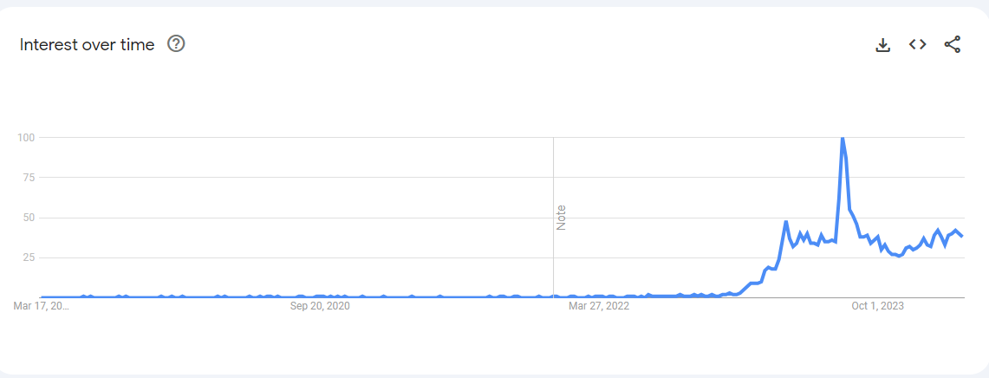
Google Trends for Prompt Engineering

Slide 3
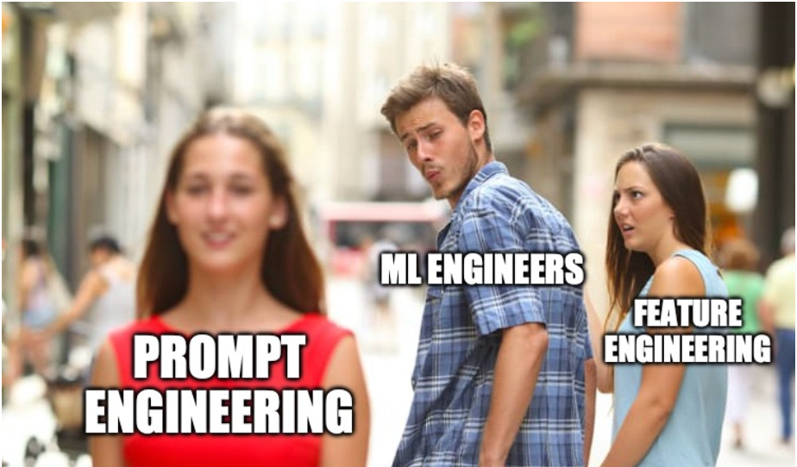
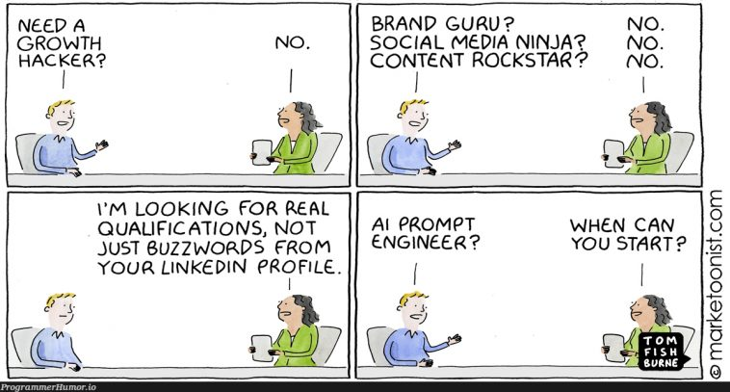

Slide 4
What are Prompts ?.
Prompts involve instructions and context passed to a language model to achieve a desired task.

Slide 5
What is Prompt Engineering?.
Prompt Engineering is the practice of developing and optimizing prompts to efficiently use language models(LLMs).

Slide 6

WHY WE NEED PROMPT ENGINEERING ?.
LLMs are trained on a massive amount of text data, and they can be fussy and may not always understandable what you are asking them to do.

Slide 7

Let start learning Prompt engineering

Slide 8
Types of Prompt Engineering
Zero Shot
One Shot
Few Shot
Chain of Thought(CoT)

Slide 9
Zero Shot Prompting
Zero-shot prompting involves using a pre-trained language model to generate text in response to a task or query that it hasn't been specifically trained on.
Example:
Prompt: "Translate the following English text to French: 'Hello, how are you?’”
Generated Response: "Bonjour, comment ça va ?"

Slide 10

One Shot Prompting:
One-shot prompting takes the concept of zero-shot a step further.

Slide 11
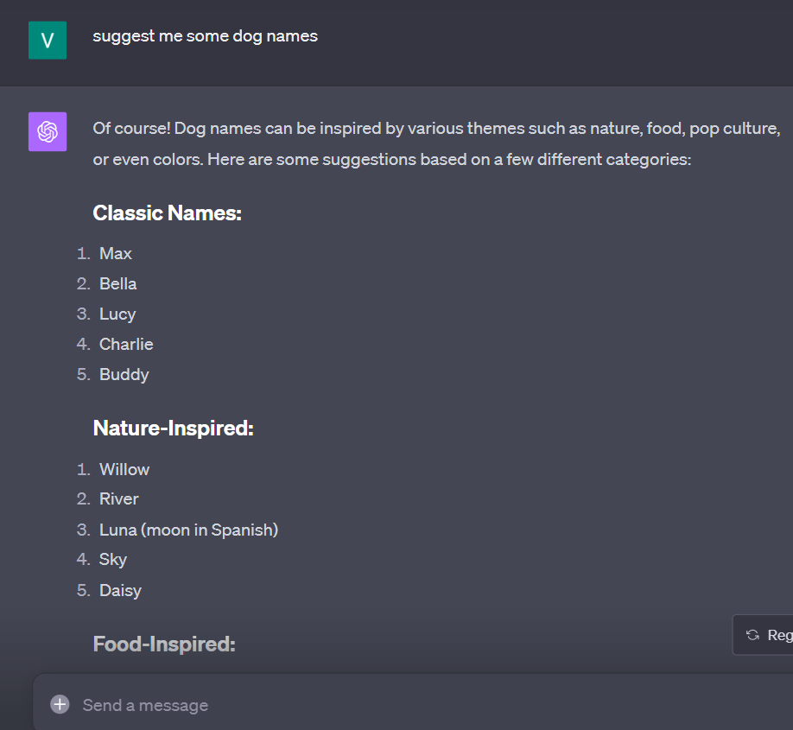
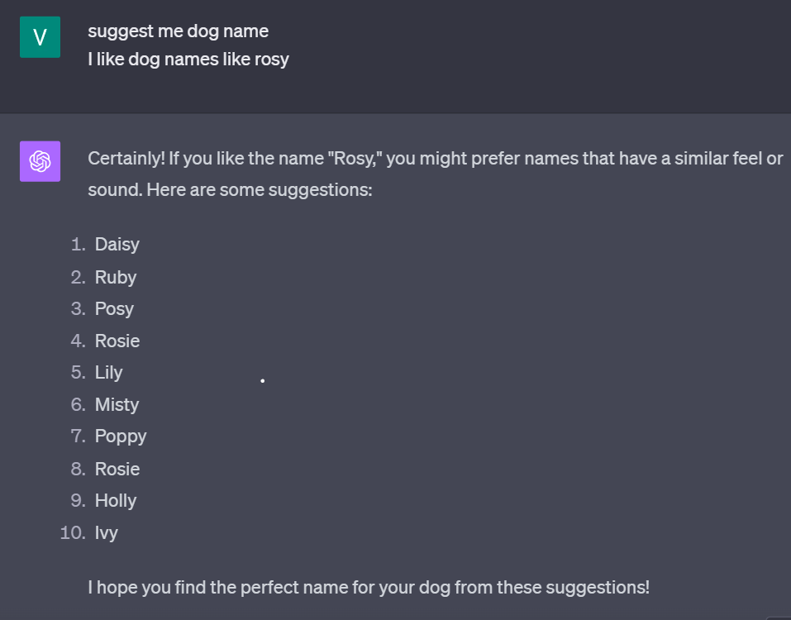
EXAMPLE:

Slide 12
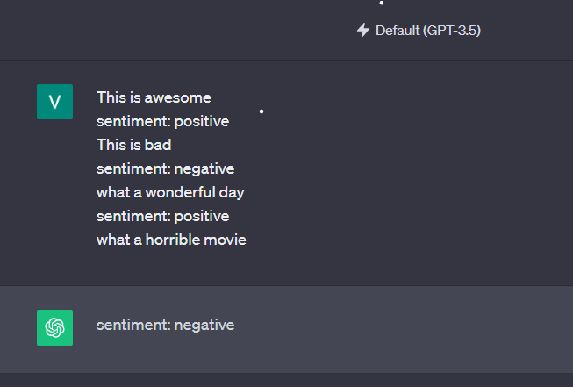
2. Few shot prompting
It is a technique where we provide a machine learning model with a handful of examples (or "shots") to demonstrate a specific task.

Slide 13

Chain of Thought (CoT)
Introduced by Google Research, Brain Team.
It comes from few shot prompting.
It is a coherent series of intermediate reasoning steps that lead to the final answer for a problem.
CoT enables large language models to tackle complex arithmetic, commonsense, and symbolic reasoning tasks.

Slide 14
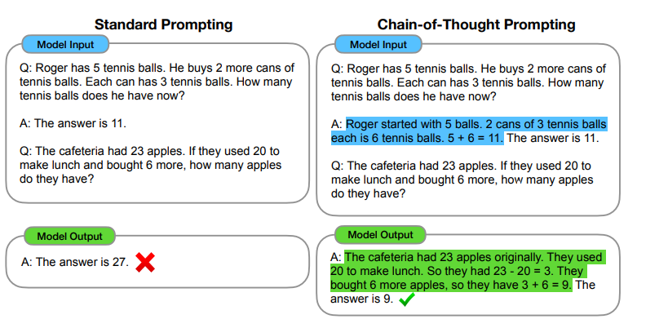
EXAMPLE:

Slide 15
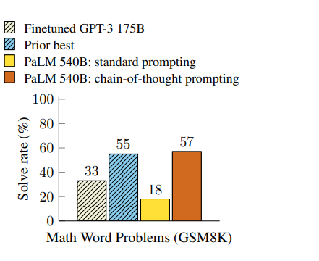
Benefits of CoT:
Multi step problem solving
Model Transparency
Versatile applications
Easy Integration

Slide 16
HOW TO USE PROMPT ENGINNERING
Structure our prompts with simple formula.
The formula will be:
ROLE + DESCIPTION + GOAL+ QUESTIONS
Role: Giving a role to the model to act. Description: Give details about your task. Goal: Tell the model what you want to achieve. Questions: Let the model ask you questions.

Slide 17

Different Types of Roles
Persona
Audience

Slide 18
Persona Role:
Persona pattern refers to a specific style or personality that you adopt when crafting prompts to interact with AI models like ChatGPT.
It's like taking on the role of a character to get the desired response.
Act as Persona X
Perform task Y

Slide 19
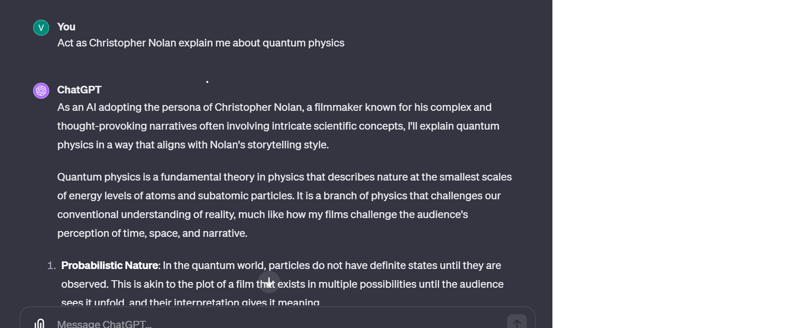
Example:

Slide 20
Audience persona
Prompt engineering involves crafting queries or instructions for AI models to generate specific responses.
An "audience persona pattern" typically refers to tailoring prompts to a specific audience.
Explain X to me. Assume that I am Persona Y.

Slide 21
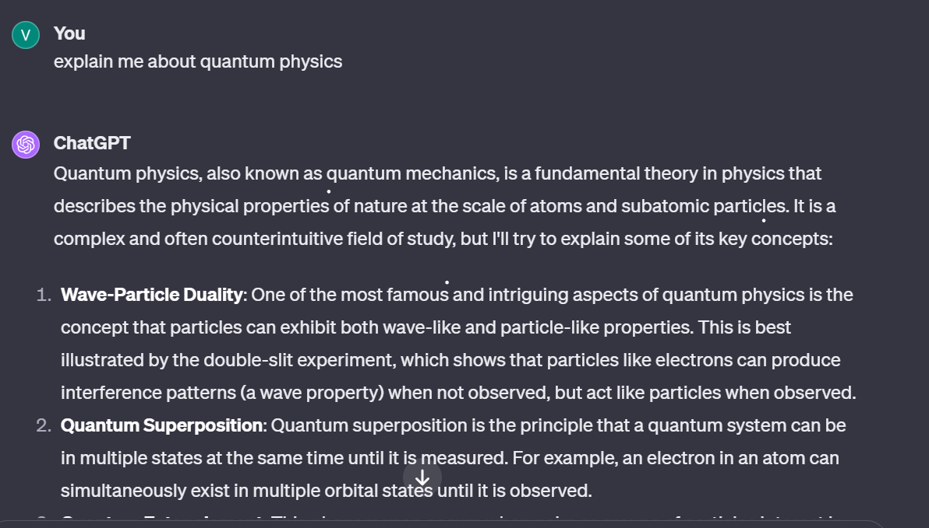
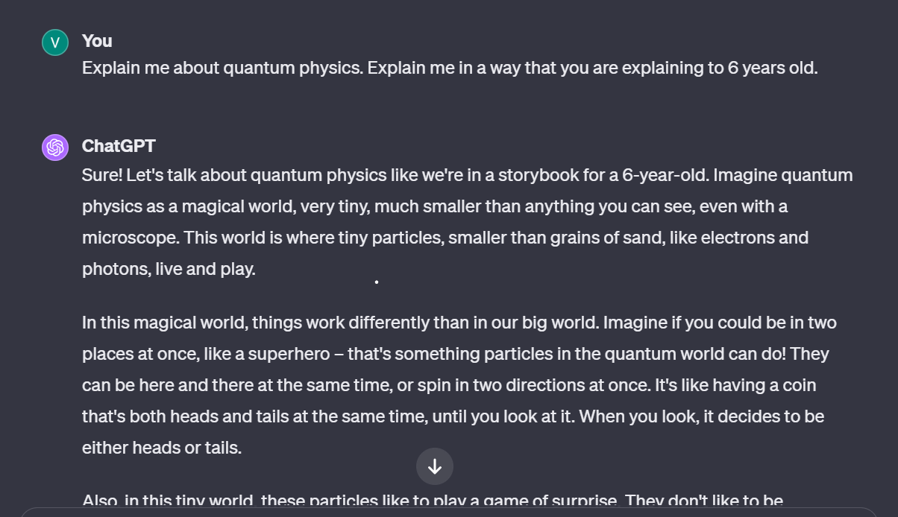
Example:

Slide 22

Question Refinement pattern
This pattern ensures the conversational LLM always suggest potentially better or more refined questions that user could ask instead of their original question.

Slide 23
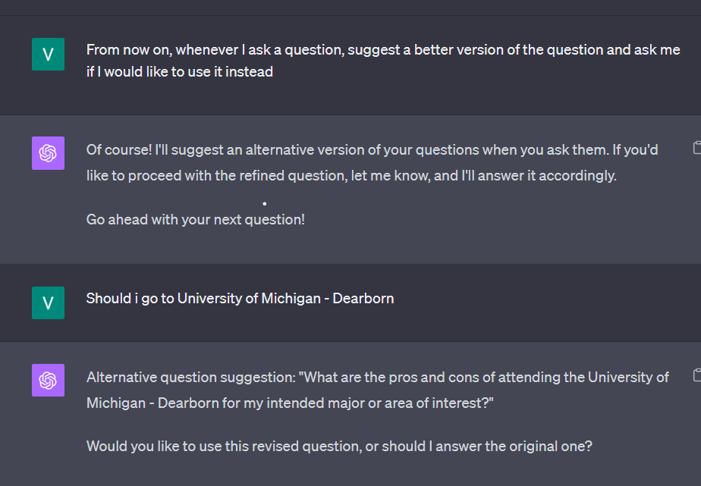
Example:

Slide 24

Difference:

Slide 25
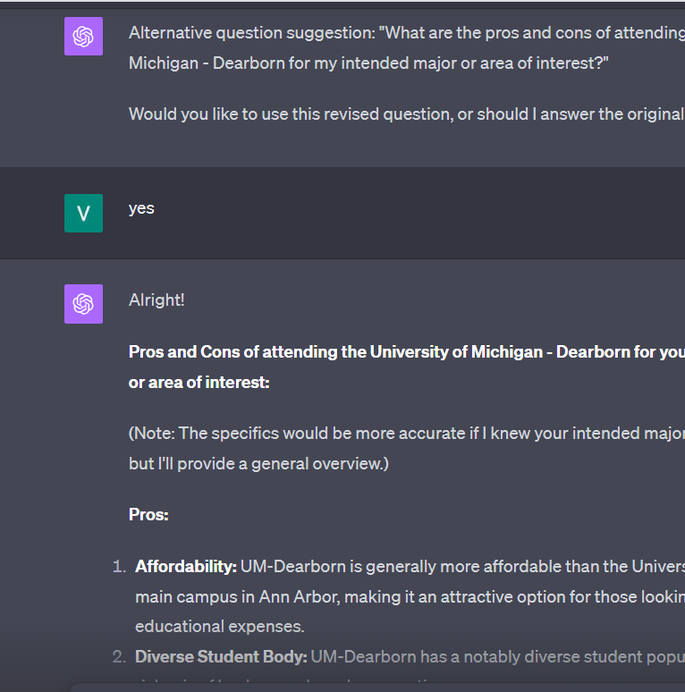
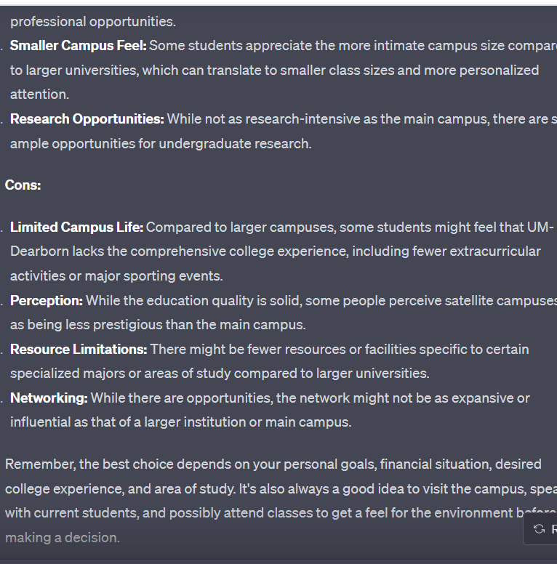

Slide 26
Cognitive Verifier Pattern
AI system actively checks its own understanding of the user's input before providing a response.
This pattern is particularly useful when dealing with ambiguous or incomplete information, ensuring the AI's responses are based on a correct understanding of the user's intent.
AI asks follow-up questions to clarify the user's intent or to gather more information.

Slide 27
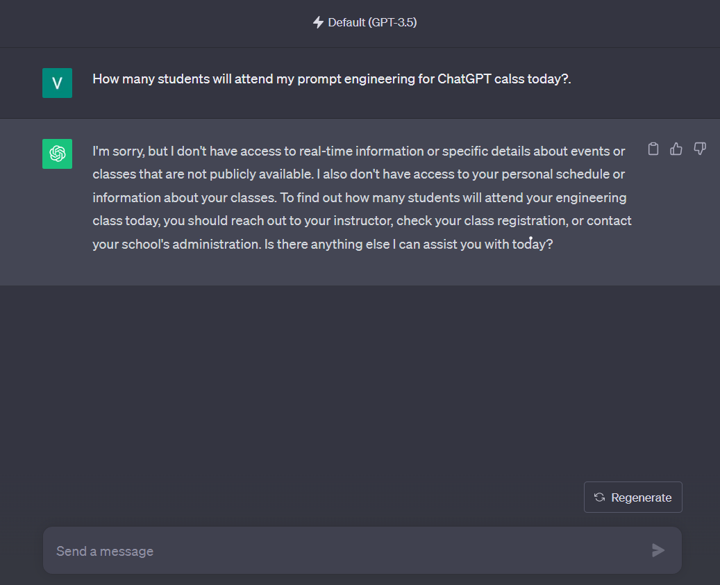
Difference

Slide 28
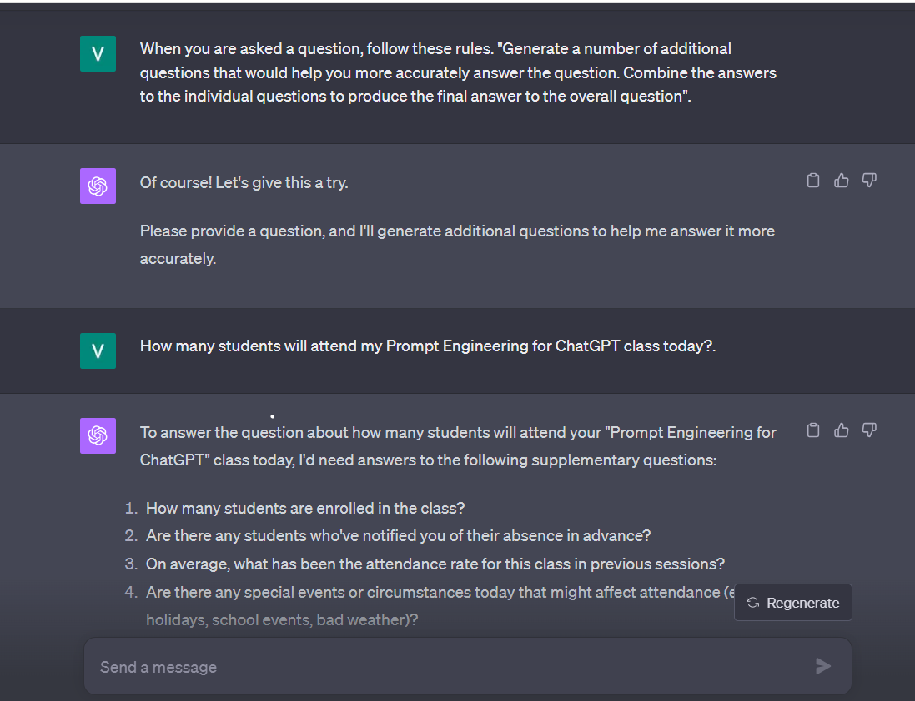
Examples:

Slide 29
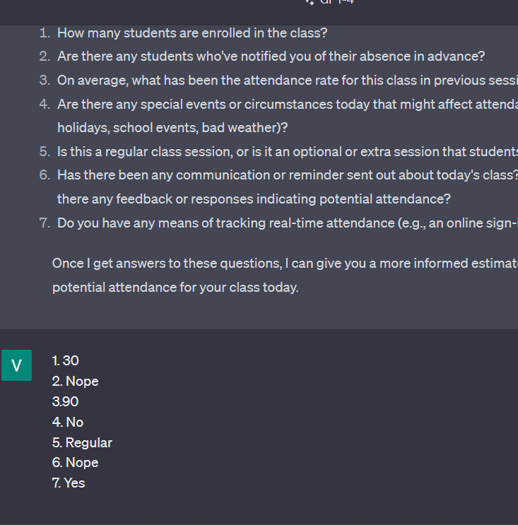
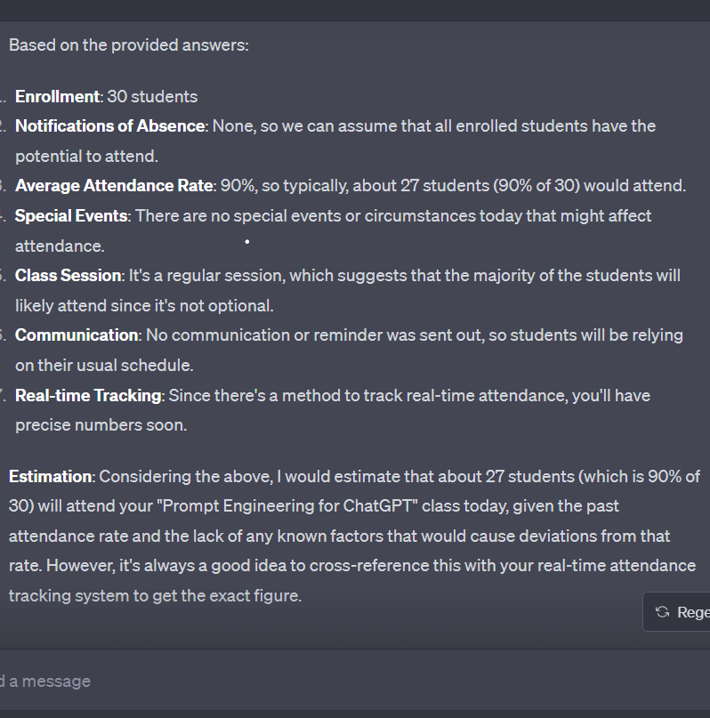

Slide 30
Flipped Interaction Pattern
The goal of the Flipped Interaction pattern is to flip(“reverse”) the interaction flow so the LLM asks the user questions to achieve some desired goal.
It primarily focuses making the AI deliver the right questions that could effectively drive us towards our desired solution.
I would like you to ask me questions to achieve X
You should ask questions until this condition is met or to achieve this goal (alternatively, forever)
(Optional) ask me the questions one at a time, two at a time, etc.

Slide 31
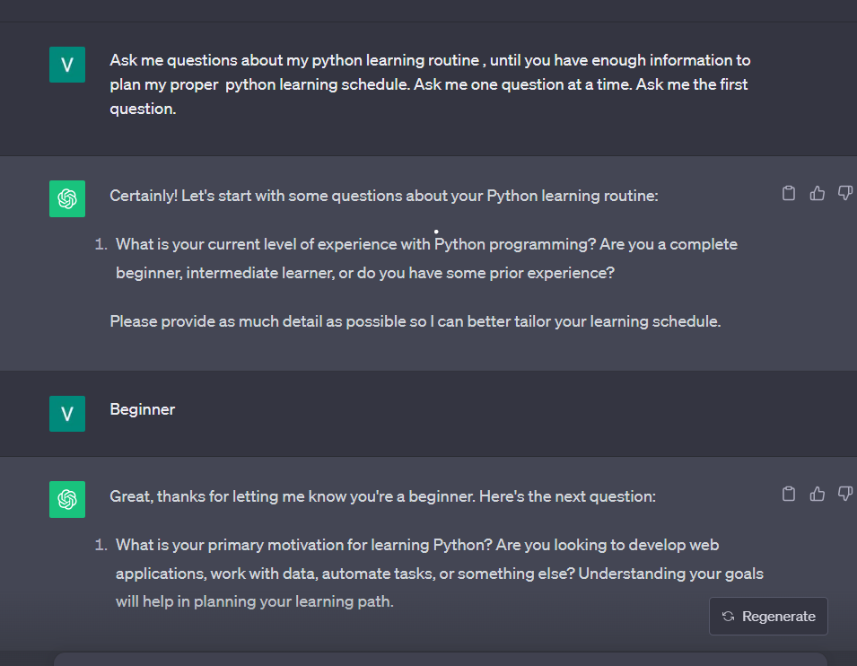

Example:

Slide 32
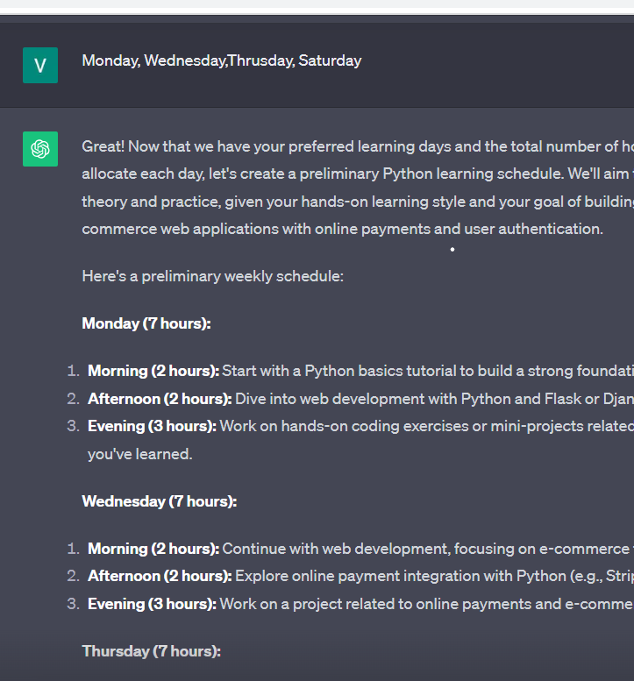
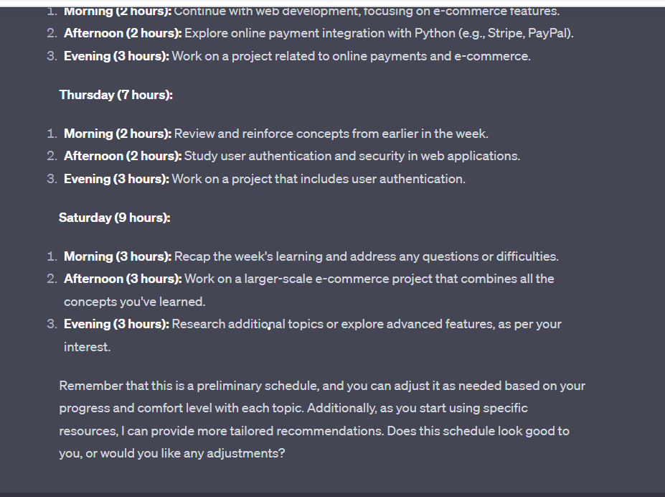
Result

Slide 33
Benefits of Prompt Engineering
Enhanced Accuracy
User Experience
Efficiency
Flexibility
Cost-effective

Slide 34
HOW TO DESIGN EFFECTIVE PROMPTS
Designing prompts
Assign Role
Provide Goal
Be Specific
Add conditions
Provide sufficient Data
Let AI ask questions!!

Slide 35
EXAMPLE:
Act as computer science professor, you have 10 years of experience in teaching AI, and you are good with all types of AI related technologies. Now your goal is to assess and give feedback to my Grad AI project proposal..
Please let me know If you have any questions Please ask before assessing and giving feedback
Please only state the facts from Liable resources but not on your own.

Slide 36

ATTENTION !!!
Don’t make AI to kill your imagination and creativity.
Don’t get addicted to AI.
Don’t get distracted by AI.
To much of a good thing can be bad.
Articles: https://www.linkedin.com/pulse/chat-gpt-good-students-exploring-pros-cons-side-effects-learningsol/
https://www.linkedin.com/pulse/art-prompt-engineering-crafting-customisable-learning-mark-j8xfe/ https://developers.google.com/machine-learning/resources/prompt-eng
https://www.techbusinessnews.com.au/blog/chatgpt-may-lead-to-the-downfall-of-eduction-and-critical- thinking/#:~:text=Reduces%20creativity%3A%20Chat%20GPT%20generates,learn%20and%20understand%20the%20material.

Slide 37

FUN TIME
Storytelling

Slide 38

Learning Resources:
W3 Schools: https://www.w3schools.com/gen_ai/chatgpt-3-5/index.php
DeepLearning.AI: https://www.deeplearning.ai/short-courses/chatgpt-prompt-engineering-for-developers/
ChatGPT
Youtube Tutorials

Slide 39

THANK YOU

